Slide 1
State Space Search for Solving problems
Lecture Module 4

Slide 2
State Space Search
State space is another method of problem representation that facilitates easy search similar to PS.
In this method also problem is viewed as finding a path from start state to goal state.
A solution path is a path through the graph from a node in a set S to a node in set G.
Set S contains start states of the problem.
A set G contains goal states of the problem.
The aim of search algorithm is to determine a solution path in the graph.

Slide 3
Contd..
A state space consists of four components.
  Set of nodes (states) in the graph/tree. Each node represents the state in problem solving process.
  Set of arcs connecting nodes. Each arc corresponds to operator that is a step in a problem solving process.
  Set S containing start states of the problem.
  Set G containing goal states of the problem.

Slide 4
Missionaries and Cannibals
The possible operators applied in this problem are {2M0C, 1M1C, 0M2C, 1M0C, 0M1C}.
Here M is missionary and C is cannibal.
  Digit before these characters means number of missionaries and cannibals possible at any point in time.
These operators can be applied in both the situations i.e., if boat is on left bank then we write “Operator →” and if the boat is on right bank of the river then we write “Operator ←”.

Slide 5
For the sake of simplicity, let us represent state (L:R),where L= n₁m₁1 and R = n₂m₂0.
Here boat with 1 or 0 representing presence of absence of the boat.
  Start state: (331:000)
  Goal state: (000:331)

Slide 6
Illegal states, operators
Invalid state such as (121:210) would lead to one missionary and two cannibals on the left bank which is not a possible state.
Given a valid state, say, (221:110), the operator 0M1C or 0M2C would be illegal.
Looping situations are to be avoided.

Slide 7
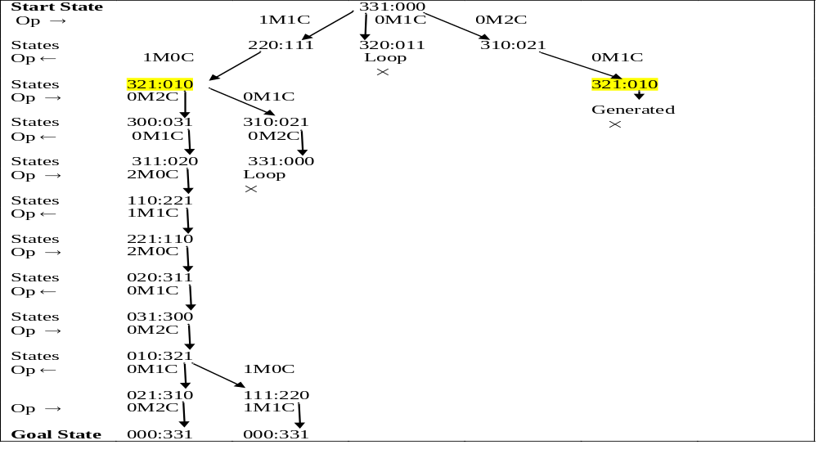

Slide 8
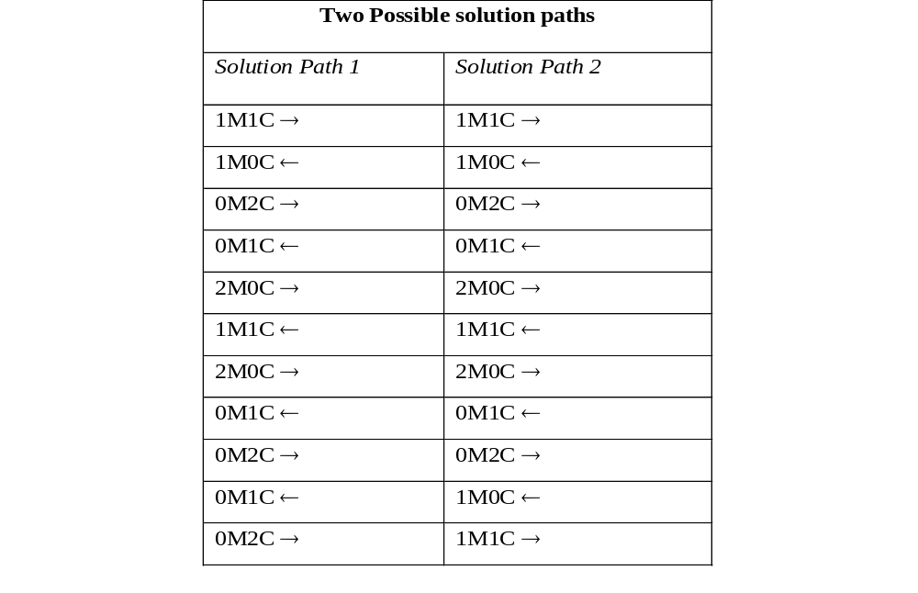

Slide 9
The 8-Puzzle
Problem Statement:
The eight puzzle problem consists of a 3 x 3 grid with 8 consecutively numbered tiles arranged on it.
Any tile adjacent to the space can be moved on it.
Solving this problem involves arranging tiles in the goal state from the start state.

Slide 10
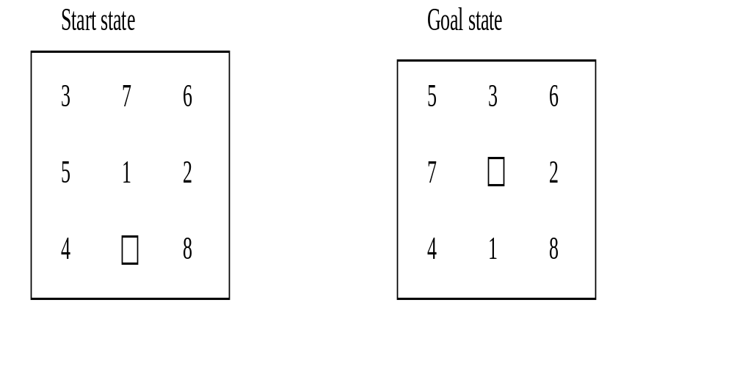

Slide 11
Solution by State Space method
The start state could be represented as: [ [3,7,2], [5,1, 2], [4,0,6] ]
The goal state could be represented as: [ [5,3,6] [7,0,2], [4,1,8] ]
The operators can be thought of moving {up, down, left, right}, the direction in which blank space effectively moves.

Slide 12
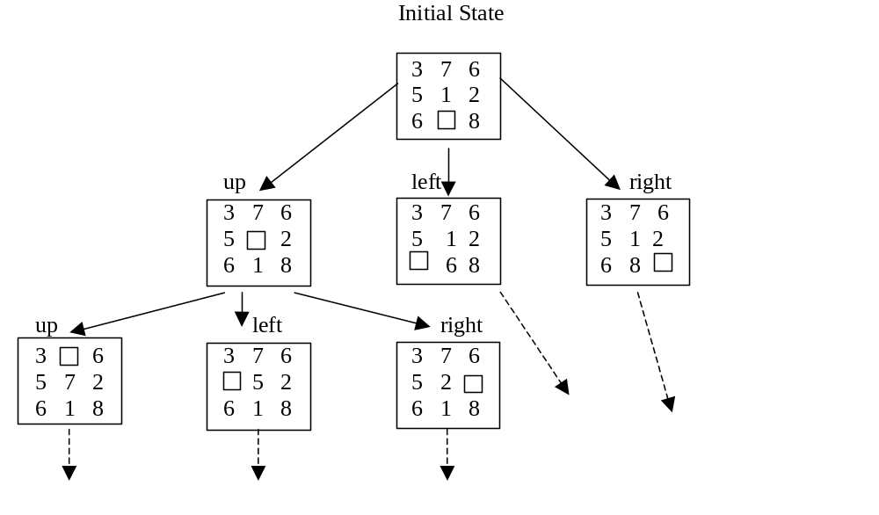

Slide 13
Searching for a Solution
Problem can be solved by searching for a solution.
Transform initial state of a problem into some final goal state.
Problem can have more than one intermediate states between start and goal states.
All possible states of the problem taken together are said to form
  a state space or
  problem state and
  search is called state space search.

Slide 14
Contd…
Search is basically a procedure to discover a path through a problem space from initial state to a goal state.
There are two directions in which such a search could proceed.
  Data driven search, forward, from the start state
  Goal driven search, backward, from the goal state

Slide 15
Forward Reasoning (Chaining):
It is a control strategy that starts with known facts and works towards a conclusion.
For example in 8 puzzle problem, we start from initial state to goal state.
In this case we begin building a tree of move sequences with initial state as the root of the tree.
Generate the next level of the tree by finding all rules whose left sides match with root and use their right side to create the new state.
Continue until a configuration that matches the goal state is generated.
Language OPS5 uses forward reasoning rules. Rules are expressed in the form of “if-then rule”.
Find out those sub-goals which could generate the given goal.

Slide 16
Backward Reasoning (Chaining)
It is a goal directed control strategy that begins with the final goal.
Continue to work backward, generating more sub goals that must also be satisfied in order to satisfy main goal.
Prolog (Programming in Logic) uses this strategy.

Slide 17
General observations
If there are large number of explicit goal states and one initial state,
  then it would not be efficient to try to solve this in backward direction as we don’t know which goal state is closest to the initial state. So it is better to reason forward.
If problem has a single initial state and a single goal state, it makes no difference whether the problem is solved in the forward or the backward direction.
  The computational effort is the same. In both these cases, same state space is searched but in different order.
Move from the smaller set of states to the larger set of states.
Proceed in the direction with the lower branching factor (the average number of nodes that can be reached directly from single node).

Slide 18
Contd…
In mathematics, suppose we have to prove a theorem.
  There are initial states as small set of axioms.
  From these set of axioms, we can prove large number of theorems.
On the other hand, the large number of theorems must go back to the small set of axioms.
  So branching factor is significantly greater going forward from axioms to theorem than going from theorems to axioms.

Slide 19
General Purpose Search Strategies
Breadth First Search (BFS)
  It expands all the states one step away from the initial state, then expands all states two steps from initial state, then three steps etc., until a goal state is reached.
  It expands all nodes at a given depth before expanding any nodes at a greater depth.
  All nodes at the same level are searched before going to the next level down.
  For implementation, two lists called OPEN and CLOSED are maintained.
    The OPEN list contains those states that are to be expanded and CLOSED list keeps track of states already expanded.
    Here OPEN list is used as a queue.

Slide 20
        Algorithm (BFS)
Input: Two states in the state space START and GOAL
Local Variables: OPEN, CLOSED, STATE-X, SUCCS
Output: Yes or No
Method:
Initially OPEN list contains a START node and CLOSED list is empty; Found = false;
While (OPEN ≠ empty and Found = false)
Do {
  Remove the first state from OPEN and call it STATE-X;
  Put STATE-X in the front of CLOSED list;
  If STATE-X = GOAL then Found = true else
{- perform EXPAND operation on STATE-X, producing a list of SUCCESSORS;
- Remove from successors those states, if any, that are in the CLOSED list;
- Append SUCCESSORS at the end of the OPEN list /*queue*/
    } } /* end while */
If Found = true then return Yes else return No and Stop

Slide 21
Depth-First Search
In depth-first search we go as far down as possible into the search tree / graph before backing up and trying alternatives.
  It works by always generating a descendent of the most recently expanded node until some depth cut off is reached
  then backtracks to next most recently expanded node and generates one of its descendants.
So only path of nodes from the initial node to the current node is stored in order to execute the algorithm.
For implementation, two lists called OPEN and CLOSED with the same conventions explained earlier are maintained.
  Here OPEN list is used as a stack.
  If we discover that first element of OPEN is the Goal state, then search terminates successfully else move it to closed list and stack its successor in open list.

Slide 22
Algorithms (DFS)
Input: Two states in the state space, START and GOAL
LOCAL Variables: OPEN, CLOSED, RECORD-X, SUCCESSORS
Output: A path sequence if one exists, otherwise return No
Method:
Form a stack consisting of (START, nil) and call it OPEN list. Initially set CLOSED list as empty; Found = false;
While (OPEN ≠ empty and Found = false) DO
{
Remove the first state from OPEN and call it RECORD-X;
Put RECORD-X in the front of CLOSED list;
If the state variable of RECORD-X= GOAL,
then Found = true

Slide 23
Else
{ - Perform EXPAND operation on STATE-X, a state variable of RECORD-X, producing a list of action records called SUCCESSORS; create each action record by associating with each state its parent.
- Remove from SUCCESSORS any record whose state variables are in the record already in the CLOSED list.
- Insert SUCCESSORS in the front of the OPEN list /* Stack */
}
}/* end while */
If Found = true then return the plan used /* find it by tracing through the pointers on the CLOSED list */ else return No
Stop

Slide 24
Comparisons
DFS
  is effective when there are few sub trees in the search tree that have only one connection point to the rest of the states.
  can be dangerous when the path closer to the START and farther from the GOAL has been chosen.
  Is best when the GOAL exists in the lower left portion of the search tree.
  Is effective when the search tree has a low branching factor.
BFS
  can work even in trees that are infinitely deep.
  requires a lot of memory as number of nodes in level of the tree increases exponentially.
  is superior when the GOAL exists in the upper right portion of a search tree.

Slide 25
Depth First Iterative Deepening (DFID)
DFID is an iterative method that expands all nodes at a given depth before expanding any nodes at greater depth.
For a given depth d, DFID performs a DFS and never searches deeper than depth d and d is increased by 1 in next iteration if solution is not found.
Advantages:
  It takes advantages of both the strategies (BFS & DFS) and suffers neither the drawbacks of BFS nor of DFS on trees
  It is guaranteed to find a shortest - length (path) solution from initial state to goal state (same as BFS).
  Since it is performing a DFS and never searches deeper than depth d. the space it uses is O(d) (same as DFS).
Disadvantages:
  DFID performs wasted computation prior to reaching the goal depth but time complexity remains same as that of BFS and DFS

Slide 26
Algorithm (DFID)
Initialize d = 1 /* depth of search tree */ , Found = false
While (Found = false)
{
  perform a depth first search from start to depth d.
  if goal state is obtained then Found = true else discard the nodes generated in the search of depth d
  d = d + 1
}/* end while */
Report the solution
Stop

Slide 27
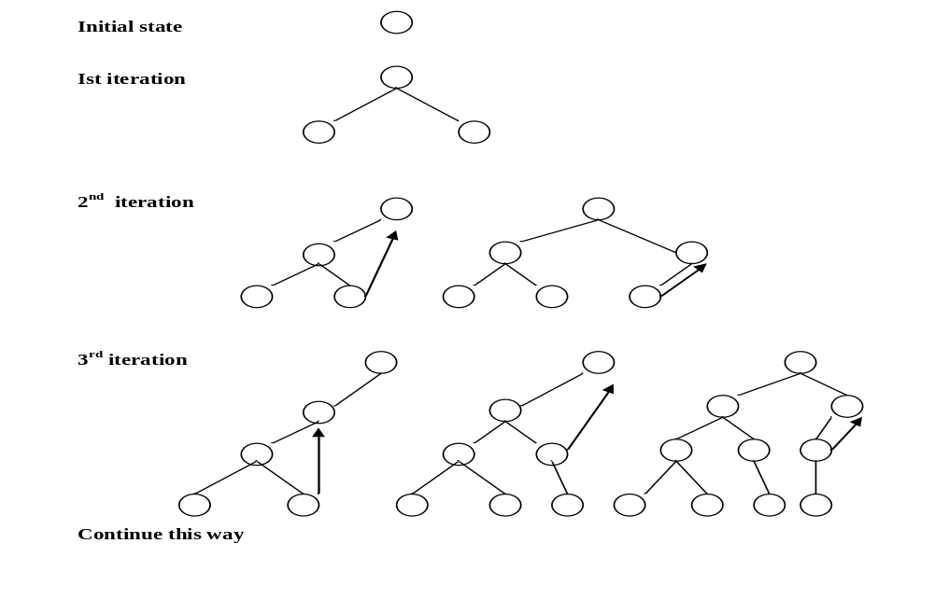
Working of DFID

Slide 28
Analysis of Search methods
Effectiveness of a search strategy in problem solving can be measured in terms of:
  Completeness: Does it guarantees a solution when there is one?
  Time Complexity: How long does it take to find a solution?
  Space Complexity: How much space does it needs?
  Optimality: Does it find the highest quality solution when there are several different solutions for the problem?

Slide 29
Performance of BFS
Time complexity
  In worst case BFS must generate all nodes up to depth d
  1 + b + b² +b³ + …+ b^{d} = O(b^{d})
    Note on average, half of the nodes at depth d must be examined.
  So average case time complexity is O(b^{d})
Space complexity
  Space required for storing nodes at depth d is O(b^{d})

Slide 30
Performance of DFS
Time complexity
  In worst case time complexity is O(b^{d})
Space complexity
  If the depth cut off is d the space requirement is O(d)
DFS requires an arbitrary cut off depth.
  If branches are not cut off and duplicates are not checked for, the algorithm may not terminate.

Slide 31
Performance of DFID
Time complexity
  nodes at depth d are generated once during the final iteration of the search
  nodes at depth d-1 are generated twice
  nodes at depth d-2 are generated thrice and so on.
  Thus the total number of nodes generated in DFID to depth d are
      T = b^{d} + 2b^{d-1} + 3b^{d-2} + …. db
      = b^{d} [1 + 2^{b-1} + 3^{b-2} + ….db^{1-d}]
      = b^{d} [1 + 2x +3x² + 4x³ + …. + dx^{d-1}] { if x = b⁻¹}
  T converges to b^{d} (1-x)⁻² for | x | < 1. Since (1-x)⁻² is a constant and independent of d, if b > 1, T ∝ O(b^{d}) Space complexity
Space complexity
  Space required for storing nodes at depth d is O(d)

Slide 32
Time Space Optimality Completeness
BFS O(b^{d}) O(b^{d}) Yes Yes
DFS O(b^{d}) O(d) ---- ----
DFID O(b^{d}) O(d) Yes Yes

Slide 33
Bi-Directional Search
For those problems having a single goal state and single start state, bi-directional search can be used.
It starts searching forward from initial state and backward from the goal state simultaneously starting the states generated until a common state is found on both search frontiers.
DFID can be applied to bi-directional search for k = 1, 2, .. as follows :
  kth iteration consists of a DFS from one direction to depth k storing all states at depth k, and
  DFS from other direction : one to depth k and other to depth k+1 not storing states but simply matching against the stored states from forward direction.
    The search to depth k+1 is necessary to find odd-length solutions.

Slide 34
Graph:
    Start
      1
2 3 4
5 6 7 8 9
10 11 12 13
    14 15
      16
Goal

Slide 35
    For k = 0
    Start
      1
______________
14 15
        16
Goal

Slide 36
    For k = 1
      Start
      1
2 3 4
_________________________________
11 12 13
14 15
      16
      Goal

Slide 37
    For k = 2
      Start
      1
2 3 4
5 6 7 8 9
_____________________________________________
11
      14
      16
      Goal

